Slide 1
Web Programming
CS518
Professor: Justin Brunelle
Team: Mehak Bhagat & Hrishi Gadkari

Slide 2
Webpage Layout and Website Design
Technical definitions:
A webpage is a single HTML document
A website is a collection of related webpages
Designing a good website requires more than just putting together a few pages

Slide 3
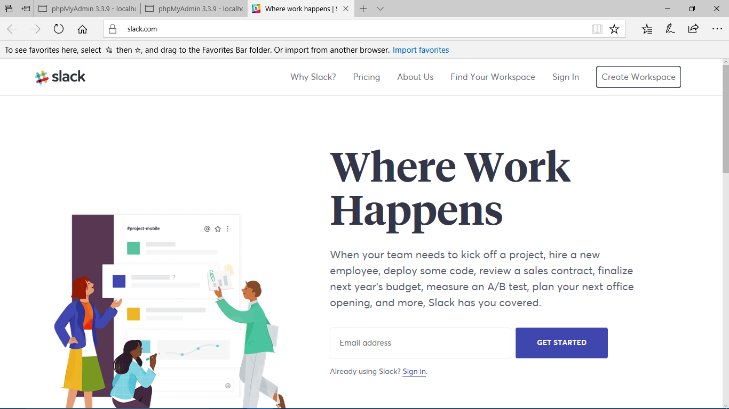
Reference
www.slack.com

Slide 4
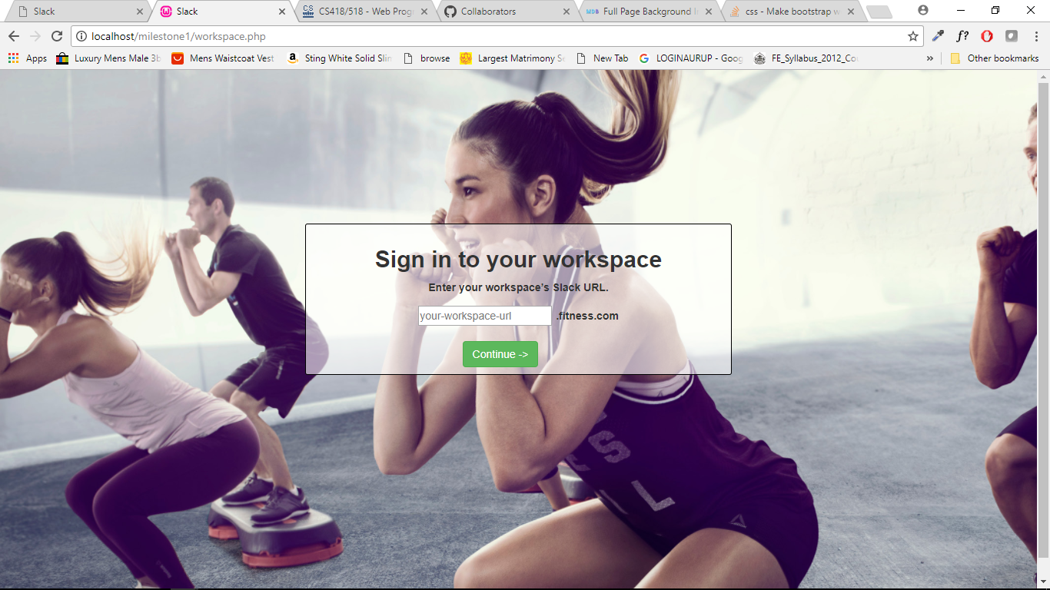
Enter your workspace

Slide 5
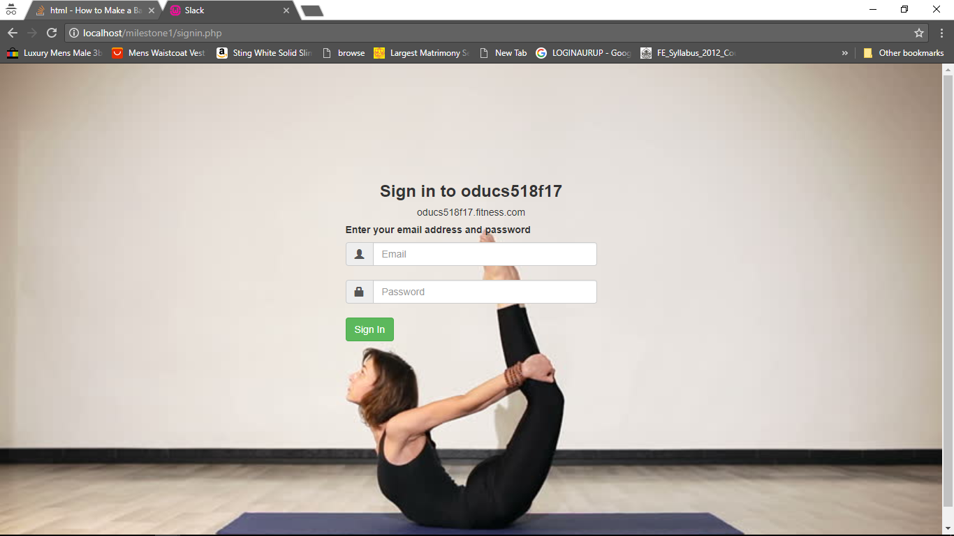
Enter Credentials

Slide 6
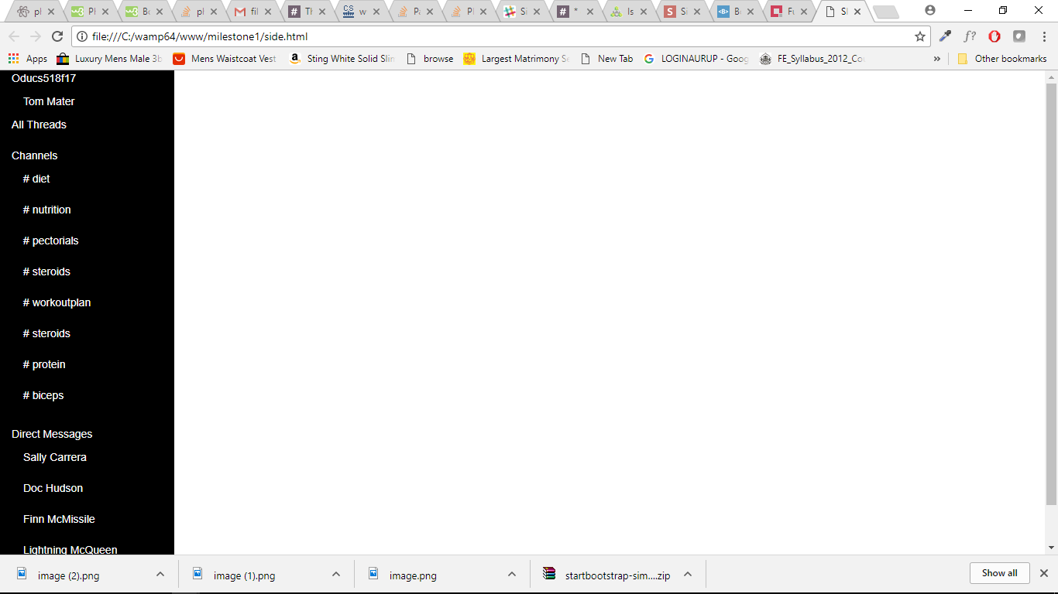
Page

Slide 7
Future To-Do
Design dashboard
Connection with database
Linking channels
Connecting users with other users for DM

